Slide 1
Information Retrieval System
Text book: Information storage & Retrieval Systems
Gerald J. Kowalski
Mark T. Maybury
Mr. T. Gnana Prakash
VNRVJIET, Bachupally, Hyd.
Some of these slides are taken or adapted from
Source: http://www.stanford.edu/class/cs276/cs276-2006-syllabus.html

Slide 2
Topics:
Introduction: Definitions
Objectives
Functional Overview
Relationship to DBMS
Digital libraries and Data Warehouses.

Slide 3
Definition of IRS
An Information Retrieval System is a system that is capable of storage, retrieval and maintenance of information.
  Information may be a text(including numeric and date data), images, video and other multimedia objects.
Information retrieval is the formal study of efficient and effective ways to extract the right bit of information from a collection.
  The web is a special case, as we will discuss.

Slide 4
Conti…
An IRS consists of s/w program that facilitates a user in finding the info. the user needs.
  The system may use standard computer h/w to support the search subfunction and to convert non-textual sources to a searchable media.
The success of an IRS is how well it can minimize the user overhead for a user to find the needed info.
  Overhead from user’s perspective is the time required to find the info. needed, excluding the time for actually reading the relevant data.
  Thus, search composition, search exec., & reading non-relevant items are all aspects of IR overhead.

Slide 5
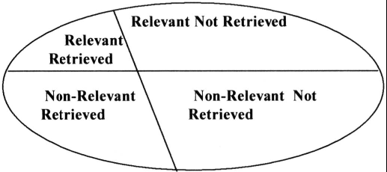
Objectives
To minimize the overhead of a user locating needed info
Two major measures
  Precision: The ability to retrieve top-ranked documents that are mostly relevant.
  Recall: The ability of the search to find all of the relevant items in the corpus.
When a user decides to issue a search looking info on a topic, the total db is logically divided into 4 segments as
Figure: Effects of search on Total Document Space

Slide 6
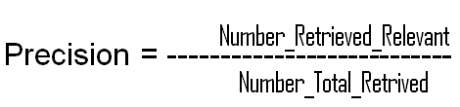

  Where Number_Possible_Relevant are the no. of relevant items in the db.
  Number _Total_Retrieved is the total no. of items retrieved from the query.
  Number _Retrieved _Relevant is the no. of items retrieved that are relevant to the user’s to the user’s search need.
  Precision measures one aspect of information retrieved overhead for a user associated with a particular search.
  If a search has a 85%, then 15% of the user effort is overhead reviewing non-relevant items.
  Recall is a very useful concept,but due to the denominator is non-calculable in operational systems.

Slide 7
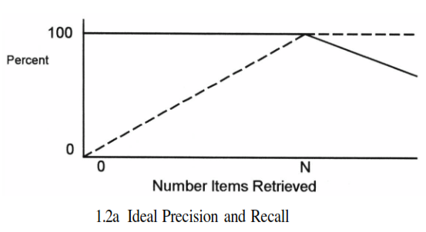
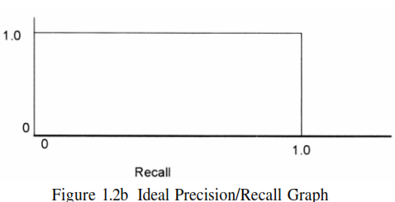
ideal case every item retrieved is relevant.
Thus precision stays at 100 per cent (1.0).
Recall continues to increase by moving to the right on the x-axis until it also reaches the 100 per cent (1.0) point.
Figure: Ideal Precision and Recall
Ideal Precision/Recall Graph

Slide 8
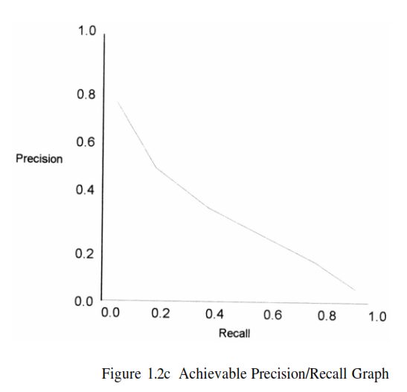
Although Figure 1.2c stops here, continuation stays at the same x-axis location (recall never changes) but precision decreases down the y-axis until it gets close to the x-axis as more non-relevant are discovered and precision decreases.

Slide 9
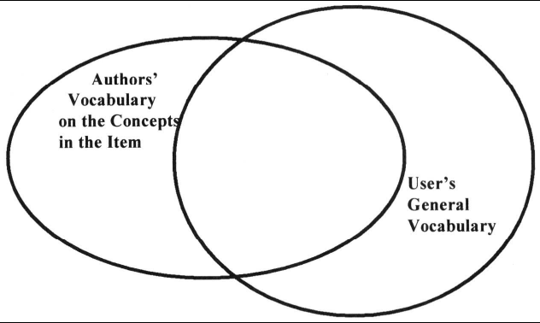
All writers have a vocabulary limited by their life experiences, environment where they were raised and ability to express themselves.
Other than in very technical restricted information domains, the user’s search vocabulary does not match the author’s vocabulary.
Users usually start with simple queries that suffer from failure rates approaching 50%
Figure: Vocabulary Domains

Slide 10

The search process…(general)
Query entered
Results Ranked
Query
Interpreted
Index
searched
Items
retrieved

Slide 11
Functional Overview
A total Information Storage and Retrieval System is composed of four major functional processes:
1. Item Normalization,
2. Selective Dissemination of Info.’n (i.e., “Mail”),
3. Document Database Search, and
4. an Index Database Search along with the
Automatic File Build process that supports
Index Files.

Slide 12
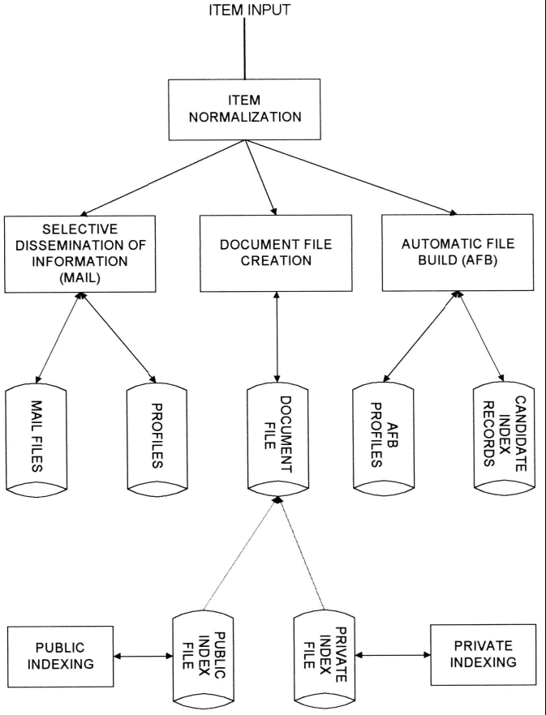
Figure shows the logical view
of these capabilities
in a single integrated Information Retrieval System.
Boxes are used in the diagram to represent functions while disks represent data storage
Figure: Total Information Retrieval System

Slide 13
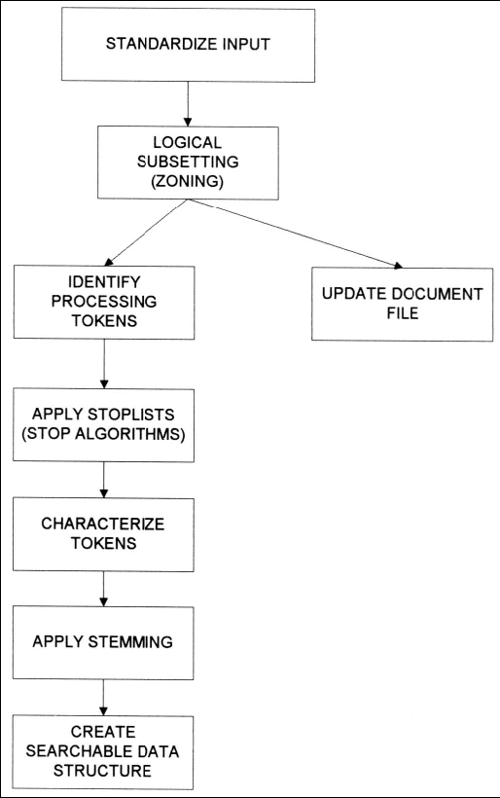
1. Item Normalization
1. In any integrated
System is to
Normalize the
Incoming items
to a standard
Format.
2. Item normalization
Provides logical
restructuring
of the item.
3. Operations during
item normalization:
Identification of
Processing tokens,
Char.’n of tokens,
Stemming of the tokens.
Figure: The Text Normalization Process

Slide 14
2. Selective Dissemination of Information
The Selective Dissemination of Information (Mail) Process provides the capability to dynamically compare newly received items in the information system against standing statements of interest of users and deliver the item to those users whose statement of interest matches the contents of the item.
Both implementers and researchers have treated the dissemination process as independent from the rest of the information system.

Slide 15
3. Document Database(DDB) Search
The DDB Search Process provides the capability for a query to search against all items received by the system.
The DDB Search process is composed of the search process, user entered queries (typically ad hoc queries) and the document db which contains all items that have been received, processed and stored by the system.
The DDB can be very large, hundreds of millions of items or more.
Typically items in the DDB do not change (i.e., are not edited) once received. The value of much information quickly decreases over time.

Slide 16
4. Index Database Search
In this process the user can logically store an item in a file along with additional index terms and descriptive text the user wants to associate with the item.
It is also possible to have index records that do not reference an item, but contain all the substantive information in the index itself.
There are two classes of index files: Public and Private Index files.
Everyuser can have one or more Private Index files leading to a very large number of files.

Slide 17
Each Private Index file references only a small subset of the total number of items in the DDB.
Public Index files are maintained by professional library services personnel and typically index every item in the DDB
There is a small number of Public Index files. These files have access lists (i.e., lists of users and their privileges) that allow anyone to search or retrieve data.
Private Index files typically have very limited access lists.
To assist the users in generating indexes, especially the professional indexers, the system provides a process called Automatic File Build.

Slide 18
Relationship to DBMS
There are two major categories of systems available to process items:
  Information Retrieval Systems and
  Data Base Management Systems (DBMS).
An Information Retrieval System is software that has the features and functions required to manipulate “information” items.
DBMS that is optimized to handle “structured” data.
Structured data is well defined data (facts) typically represented by tables.
The integration of DBMS’s and Information Retrieval Systems is very important.

Slide 19
Digital libraries and Data warehouses
Two systems frequently described in the context of information retrieval are:
  Digital Libraries and Data Warehouses(DataMarts)
Libraries have been in existence since the beginning of writing and have served as a repository and retrieving information in the media it is created on.
U.S. Government and private funding for making more information available in digital form during this time the terminology evolved from electronic libraries to digital libraries.
IRS technology has addressed a small subset of the issues associated with Digital Libraries.

Slide 20
The term Data Warehouse to control the proliferation of digital information ensuring that it is known and recoverable.
Its goal is to provide to the decision makers the critical information to answer future direction questions.
A data warehouse consists(tools) of the data, an information directory that describes the contents and meaning of the data being stored, an input function that captures data and moves it to the data warehouse
Data warehouses are similar to information storage and retrieval systems in that they both have a need for search and retrieval of information.

